Slide 1

Cs 429:DATA MINING Lecture 8
Instructor:
Osama Ahmed Khan
osamaahmedkhan
Jun 29th, 2017

Slide 2
Algorithms
Inferring Rudimentary Rules
Statistical Modeling
Divide-and-Conquer: Constructing Decision Trees
Covering Algorithms: Constructing Rules
Mining Association Rules
Linear Models
Instance-Based Learning
Clustering

Slide 3
Statistical Modeling
Employs all Attributes
Equally Important and Independent
Realistic?
Works well in practice

Slide 4
Statistical Modeling
Weather Forecast Problem 1
Outlook
Temperature
Humidity
Windy
Play
Yes
No
Yes
No
Yes
No
Yes
No
Yes
No
sunny
2
3
hot
2
2
high
3
4
false
6
2
9
5
overcast
4
0
mild
4
2
normal
6
1
true
3
3
rainy
3
2
cool
3
1
sunny
2/9
3/5
hot
2/9
2/5
high
3/9
4/5
false
6/9
2/5
9/14
5/14
overcast
4/9
0/5
mild
4/9
2/5
normal
6/9
1/5
true
3/9
3/5
rainy
3/9
2/5
cool
3/9
1/5

Slide 5
Statistical Modeling
A new day:
Outlook
Temperature
Humidity
Windy
Play
sunny
cool
high
true
?
likelihood of yes = 2/9 × 3/9 × 3/9 × 3/9 × 9/14 = 0.0053
likelihood of no = 3/5 × 1/5 × 4/5 × 3/5 × 5/14 = 0.0206
Normalization
Probability of yes = 0.0053 / (0.0053 + 0.0206) = 20.5%
Probability of no = 0.0206 / (0.0053 + 0.0206) = 79.5%

Slide 6
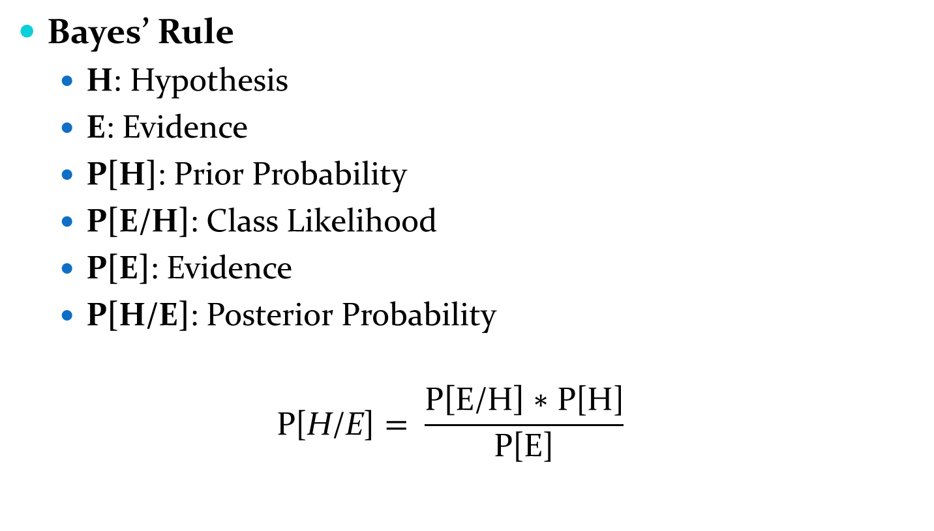
Statistical Modeling
Bayes’ Rule
H: Hypothesis
E: Evidence
P[H]: Prior Probability
P[E/H]: Class Likelihood
P[E]: Evidence
P[H/E]: Posterior Probability
$$\text{P}\text{[}\text{H}\text{/}\text{E}\text{]}= \frac{\text{P}\left[\text{E}\text{/}\text{H}\right]\text{ ∗ }\text{P}\text{[}\text{H}\text{]}}{\text{P}\text{[}\text{E}\text{]}}$$

Slide 7
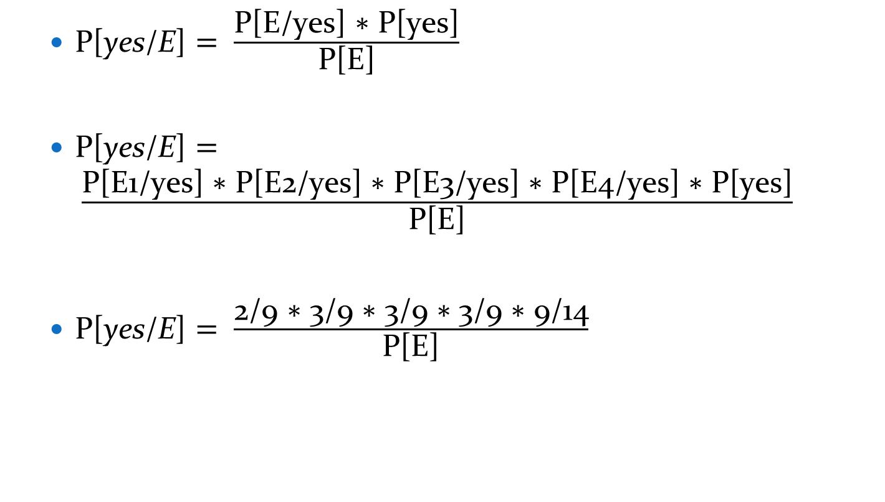
Statistical Modeling
$\text{P}\text{[}\text{yes}\text{/}\text{E}\text{]}= \frac{\text{P}\text{[}\text{E}\text{/}\text{yes}\text{] ∗ }\text{P}\text{[}\text{yes}\text{]}}{\text{P}\text{[}\text{E}\text{]}}$
$\text{P}\text{[}\text{yes}\text{/}\text{E}\text{]}= \frac{\text{P}\text{[}\text{E}\text{1}\text{/}\text{yes}\text{] ∗ }\text{P}\text{[}\text{E}\text{2}\text{/}\text{yes}\text{] ∗ }\text{P}\text{[}\text{E}\text{3}\text{/}\text{yes}\text{] ∗ }\text{P}\text{[}\text{E}\text{4}\text{/}\text{yes}\text{] ∗ }\text{P}\text{[}\text{yes}\text{]}}{\text{P}\text{[}\text{E}\text{]}}$
$\text{P}\text{[}\text{yes}\text{/}\text{E}\text{]}= \frac{\text{2}\text{/}\text{9}\text{ ∗}\text{ 3/9}\text{ ∗} \text{3/9} \text{∗} \text{3/9} \text{∗}\text{ 9/14}}{\text{P}\text{[}\text{E}\text{]}}$

Slide 8
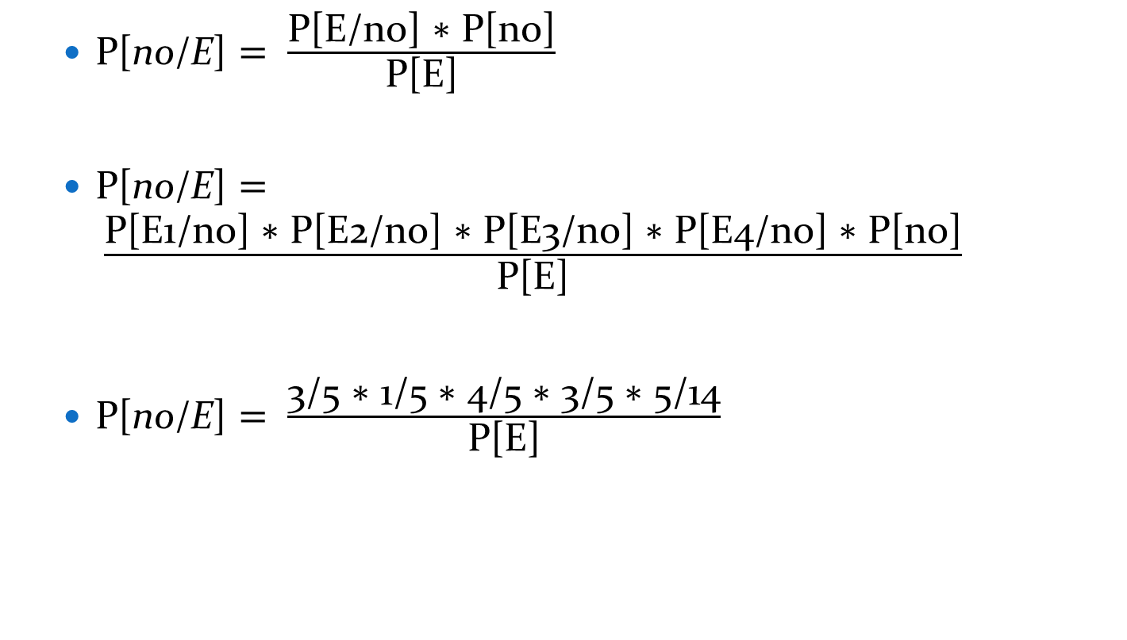
Statistical Modeling
$\text{P}\text{[}\text{no}\text{/}\text{E}\text{]}= \frac{\text{P}\text{[}\text{E}\text{/}\text{no}\text{] ∗ }\text{P}\text{[}\text{no}\text{]}}{\text{P}\text{[}\text{E}\text{]}}$
$\text{P}\text{[}\text{no}\text{/}\text{E}\text{]}= \frac{\text{P}\text{[}\text{E}\text{1}\text{/}\text{no}\text{] ∗} \text{P}\text{[}\text{E}\text{2}\text{/}\text{no}\text{] ∗} \text{P}\text{[}\text{E}\text{3}\text{/}\text{no}\text{] ∗} \text{P}\text{[}\text{E}\text{4}\text{/}\text{no}\text{] ∗} \text{P}\text{[}\text{no}\text{]}}{\text{P}\text{[}\text{E}\text{]}}$
$\text{P}\text{[}\text{no}\text{/}\text{E}\text{]}= \frac{\text{3/5}\text{ ∗} \text{1}\text{/}\text{5}\text{ ∗}\text{ 4}\text{/}\text{5} \text{∗} \text{3/}\text{5} \text{∗} \text{5}\text{/14}}{\text{P}\text{[}\text{E}\text{]}}$

Slide 9
Statistical Modeling
Naïve Bayes
Bayes’ Rule
Naïvely assumes independence among attributes
Issues
P[E_{i}/H] always >0? (e.g. P[outlook=overcast/no]=?)
Solutions
Laplace Estimator
P[outlook=sunny/no] = 3/5 = 0.6
P[outlook=overcast/no] = 0/5 = 0
P[outlook=rainy/no] = 2/5 = 0.4

Slide 10
Statistical Modeling
Solutions
Laplace Estimator
P[outlook=sunny/no] = (3+1)/(5+3) = 4/8 = 0.5
P[outlook=overcast/no] = (0+1)/(5+3) = 1/8 = 0.125
P[outlook=rainy/no] = (2+1)/(5+3) = 3/8 = 0.375
Laplace Estimator
P[outlook=sunny/no] = (3+10)/(5+30) = 13/35 = 0.371
P[outlook=overcast/no] = (0+10)/(5+30) = 10/35 = 0.286
P[outlook=rainy/no] = (2+10)/(5+30) = 12/35 = 0.343

Slide 11
Statistical Modeling
Solutions
Laplace Estimator
P[outlook=sunny/no] = (3+100)/(5+300) = 103/305 = 0.338
P[outlook=overcast/no] = (0+100)/(5+300) = 100/305 = 0.328
P[outlook=rainy/no] = (2+100)/(5+300) = 102/305 = 0.334
Use small constants for addition

